Slide 1

Cancer in Scotland
Lessons from death for life
Lesley Duff CodeClan DR22
October is Breast Cancer Awareness Month

Slide 2
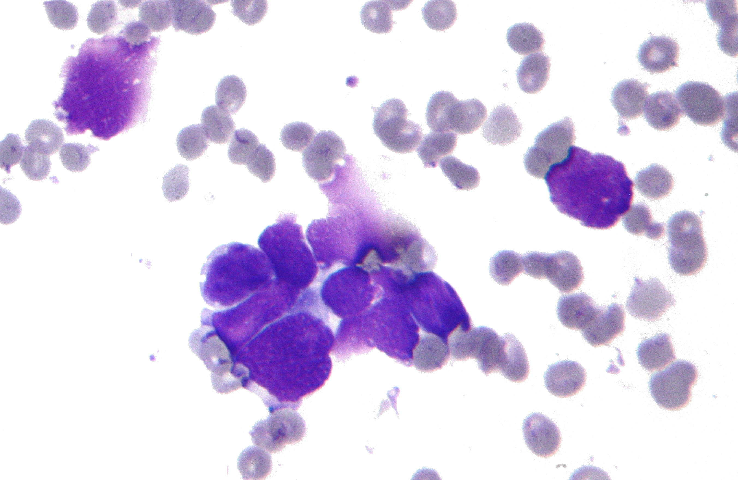
Understanding cancer data
Death Long-term effectiveness of public health campaigns and medical treatments and prevention.
Incidences New cases. Tracking existing and emerging issues
Screening programmes Early detection, take-up by citizens
Waiting times for treatment Better outcomes, shorter = better
This Photo by Unknown author is licensed under CC BY-SA.
Notes:
Talk through your approach to the business question
Lots of data, lots of places. Simplify
Brief was from point of view of Scottish Government ministers asking for information from relevant funded organisations.
High level view of the impact of cancer on the lives of people living in Scotland and for whom health services need to be funded/resourced.
Took data that would correspond with some targets set by politicians in
agreed policy documents/standards for service delivery.
Mindful that this information might be shared with general public/press releases
Death – ‘Vital Events’, National Records of Scotland (NRS)
NRS Preserving the past, Recording the present, Informing the future
WHAT IS A DEATH STATISTICALLY
‘underlying cause’ of death
In the event of a death, a death certificate is signed by a doctor, the death is then registered with the local ’Registrar’
Responsibility is divided between the Registrar General and 32 local councils who employ a total of 900 registrars.
Family history, widowed grandmother was the local ‘Registrar’ –
Scottish social history – widows were given ‘first pick’ of the job - day before social security.
Data Security in 1970s, blank forms stored in a safe in a garden shed!
Registration of Births, Deaths and Marriages (Scotland) Act 1965
Scotland's 'vital statistics' - the registers of births, marriages and deaths,
“Hatches, Matches and Dispatches”
NRS Death certificate data

Slide 3

Challenges
Lack of domain knowledge – jargon to learn. “malignant neoplasm”/”cancer site” / ICD-10 etc
Multiple sources, many available – which to choose?
Public Health Scotland – some relevant content still on 'old’ ISD website.
Excel format files more designed for readability by humans than programmatic access
Notes:
Discuss any challenges encountered and how you addressed these
Neoplasm, ICD-10 A World Health Organisation standard – more later.
ISD Scotland | Information Services Division
Excel format files – hidden sheets/rows/columns.
Source data with multiple tables on same sheet.
Footnotes on Excel files…these can be in the exported CSV files
Shiny not displaying labels – Stack Overflow to the rescue!

Slide 4
ICD-10
"... International Statistical Classification of Diseases and Related Health Problems (ICD), a medical classification list by the World Health Organization (WHO). It contains codes for diseases, signs and symptoms, abnormal findings, complaints, social circumstances, and external causes of injury or diseases"
- Wikipedia
NHS Scotland uses version ICD-10 to categorise different medical conditions.

Slide 5

Story of insights
Notes:
Present a story of your final insights which compels your client to action

Slide 6
Insights - Death
”The underlying cause of death is defined as the disease or injury which initiated the chain of morbid events leading directly to death, or the accident/act which produced the fatal injury. “ - NRS
“All ages age-standardised death rates for all causes and certain selected causes, Scotland, 1994 to 2022”
Definition: rate is deaths per 100,000 people in Scotland using using the European Standard Population.
National Records of Scotland data is © Crown Copyright 2023
Notes:
[1] "Accidents"
[2] "Alcohol-specific"
[3] "All causes"
[4] "Cancer (malignant neoplasms: 140-208 /C00-97)"
[5] "Cerebrovascular disease (stroke:430-438 / I60-69)"
[6] "Chronic Obstructive Pulmonary Disease NEW DEF(490-492,496 / J40-44)"
[7] "Covid-19"
[8] "Dementia and Alzheimer's"
[9] "Diseases of the circulatory system(390-459 / I00-I99)"
[10] "Diseases of the respiratory system(460-519 / J00-99)"
[11] "drug related"
[12] "Ischaemic (coronary) heart disease(410-414 / I20-25)"
[13] "Probable suicide"

Slide 7
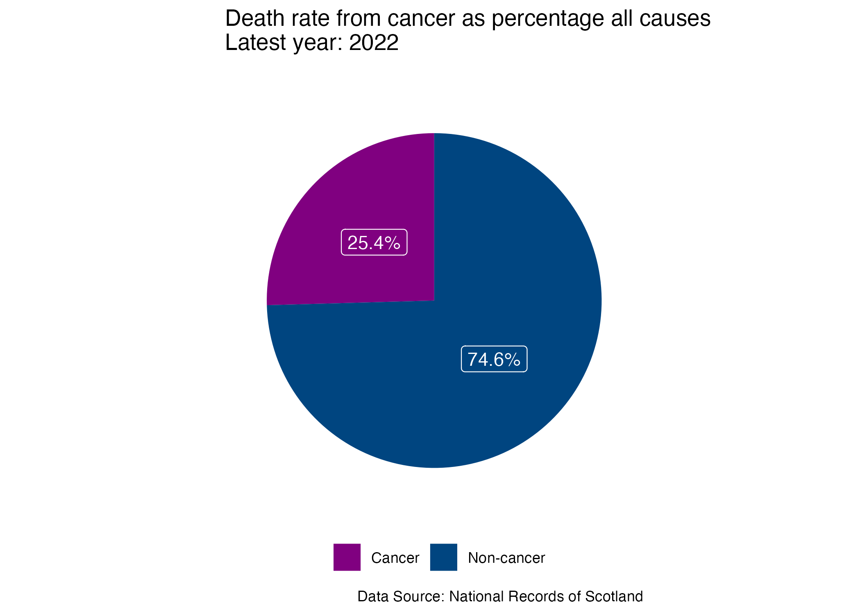
Death from cancer in Scotland compared to other causes?
Notes:
If you hear sirens in the background, it will be the Data Analysis police coming to cart me away.
For the latest year of data available
Almost exactly a quarter.

Slide 8
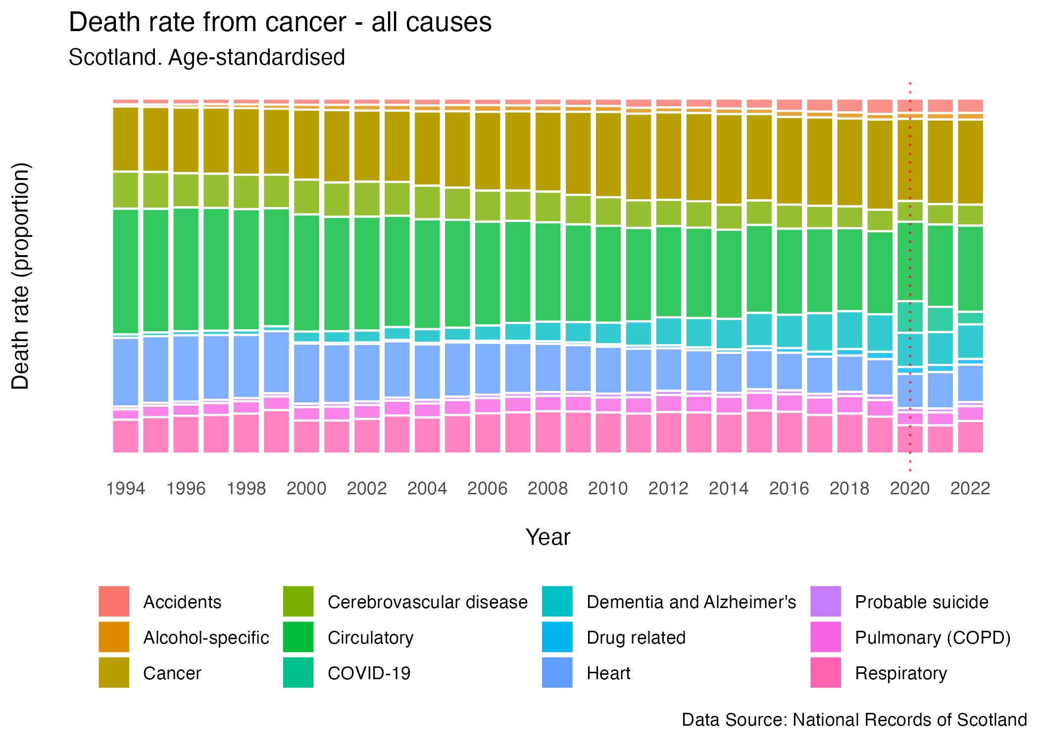
Notes:
Change over time for all causes of death
COVID - Dramatic entry 2020, brand new cause
Rate of death from cancer dropped -> vulnerable older age group
1999 Dementia coding changed from ICD-9 -> ICD 10
Even so rapid increase with wave “baby boomers” after second world war
Born in 1940s now in their 80s
This is proportions not numbers – we’ll see those in the incidences data

Slide 9
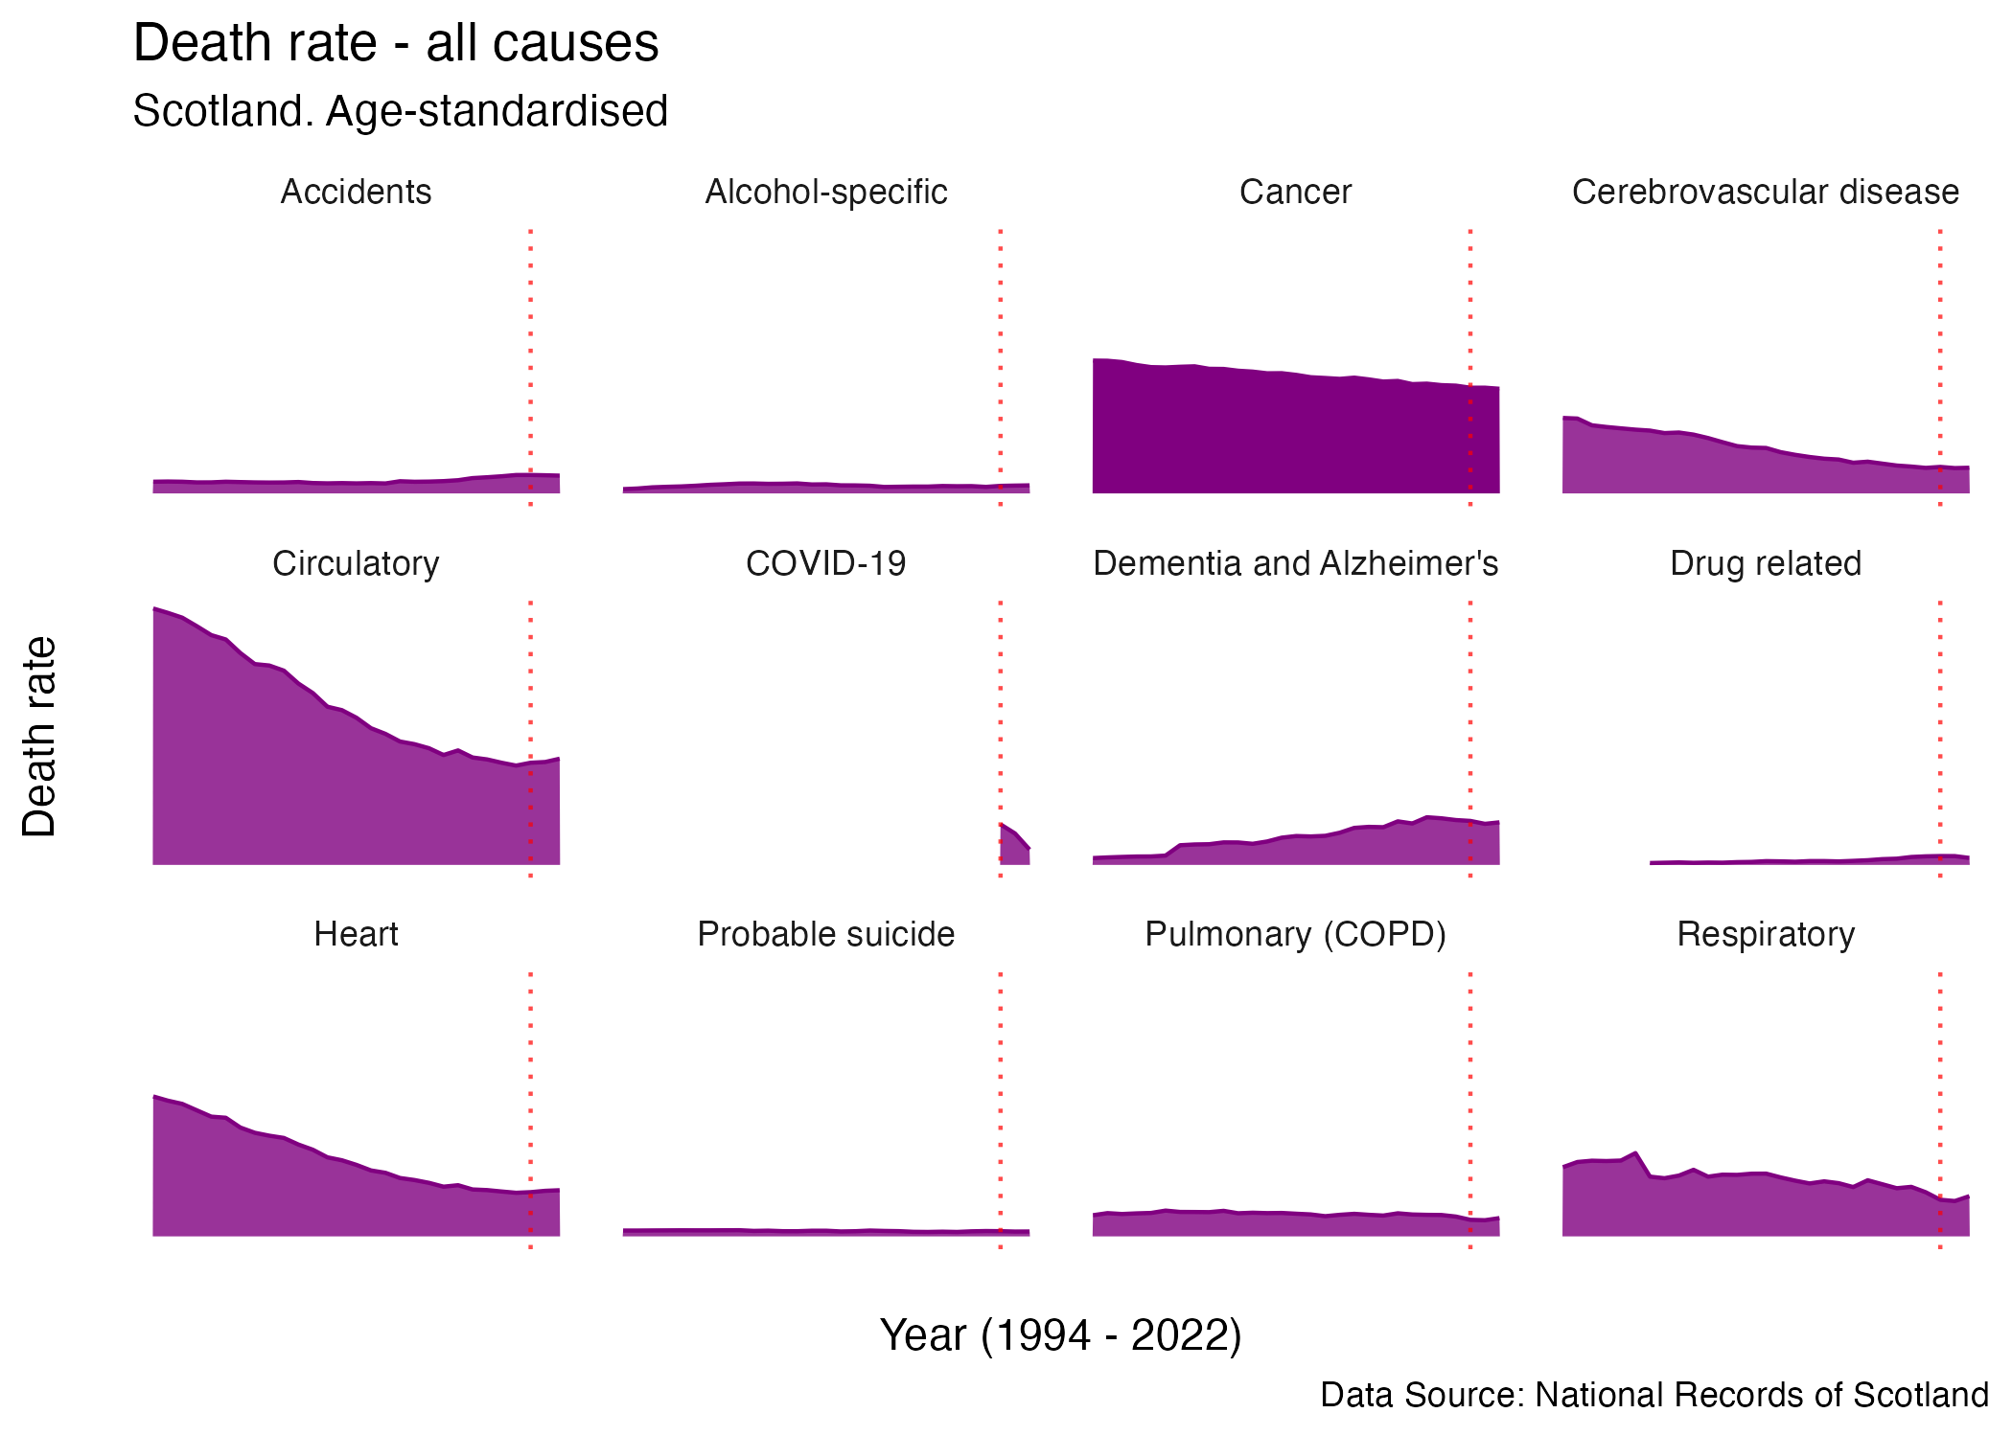

Slide 10
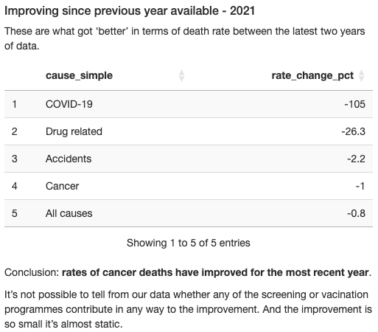

Slide 11
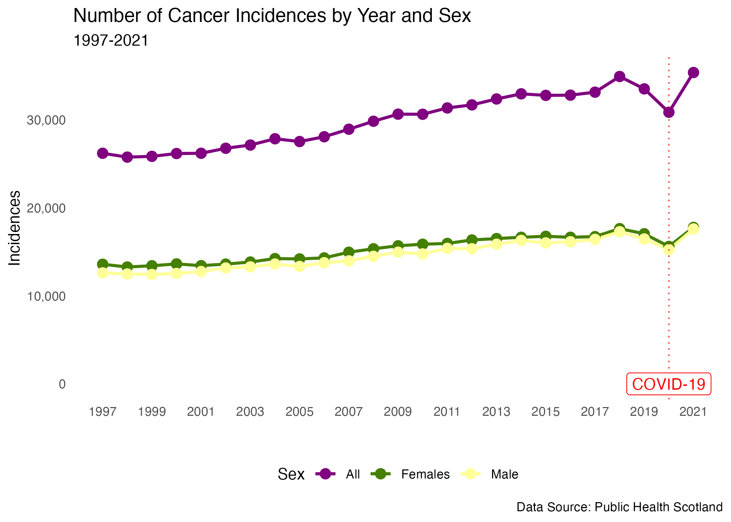
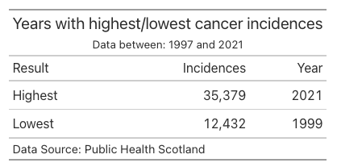
Insights – Incidences
Notes:
Sadly, most recent year of stats is the highest incidences on record.
It must be remembered that population is increasing and ageing during this time

Slide 12
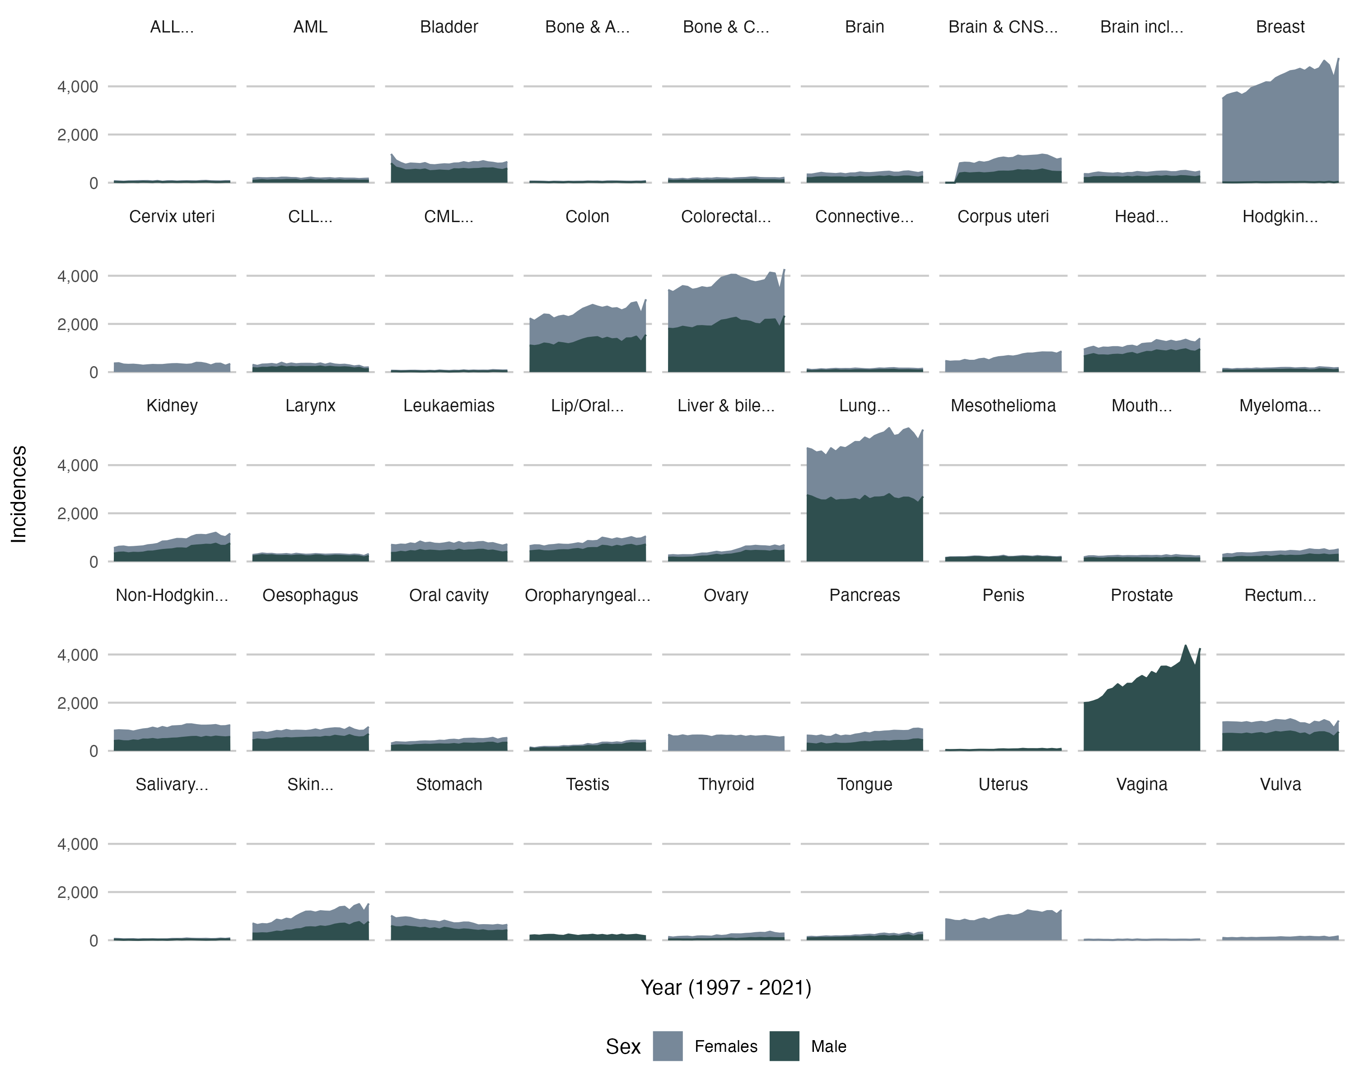
Notes:
Incidences by Year and Cancer Sites
Colorectal = Colon + Rectum
Lung largest for both sexes
Breast = female
Prostate male

Slide 13
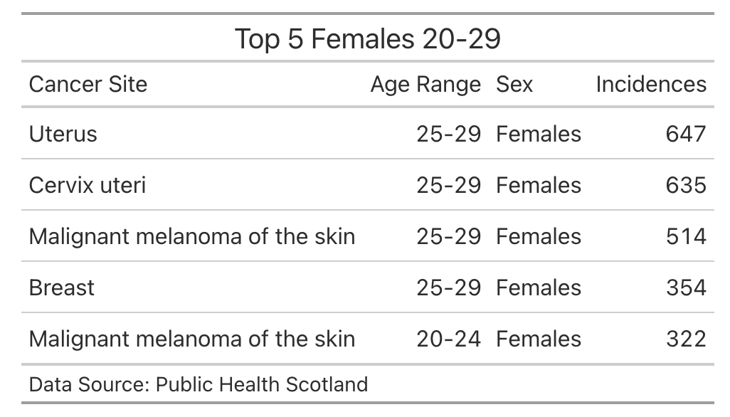
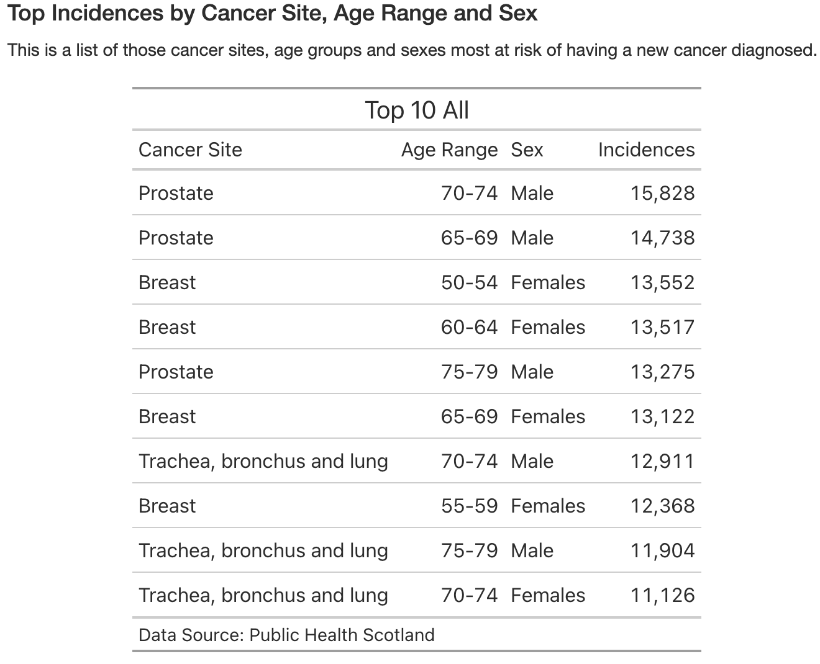
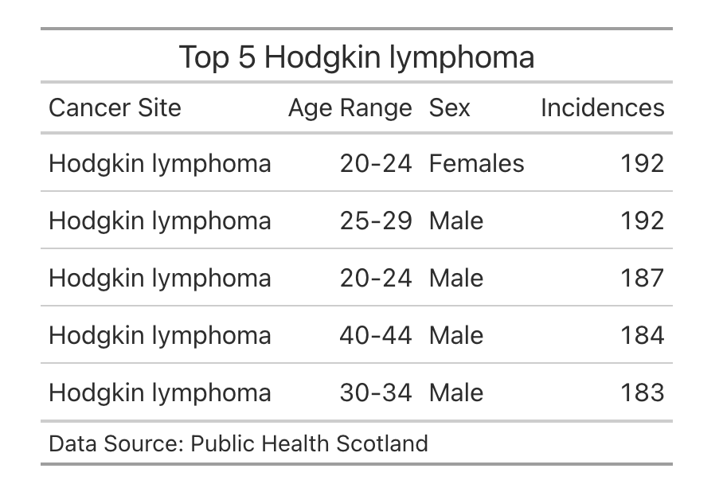
Age Range
Notes:
There is a wide variation in which cancers are more prevalent

Slide 14
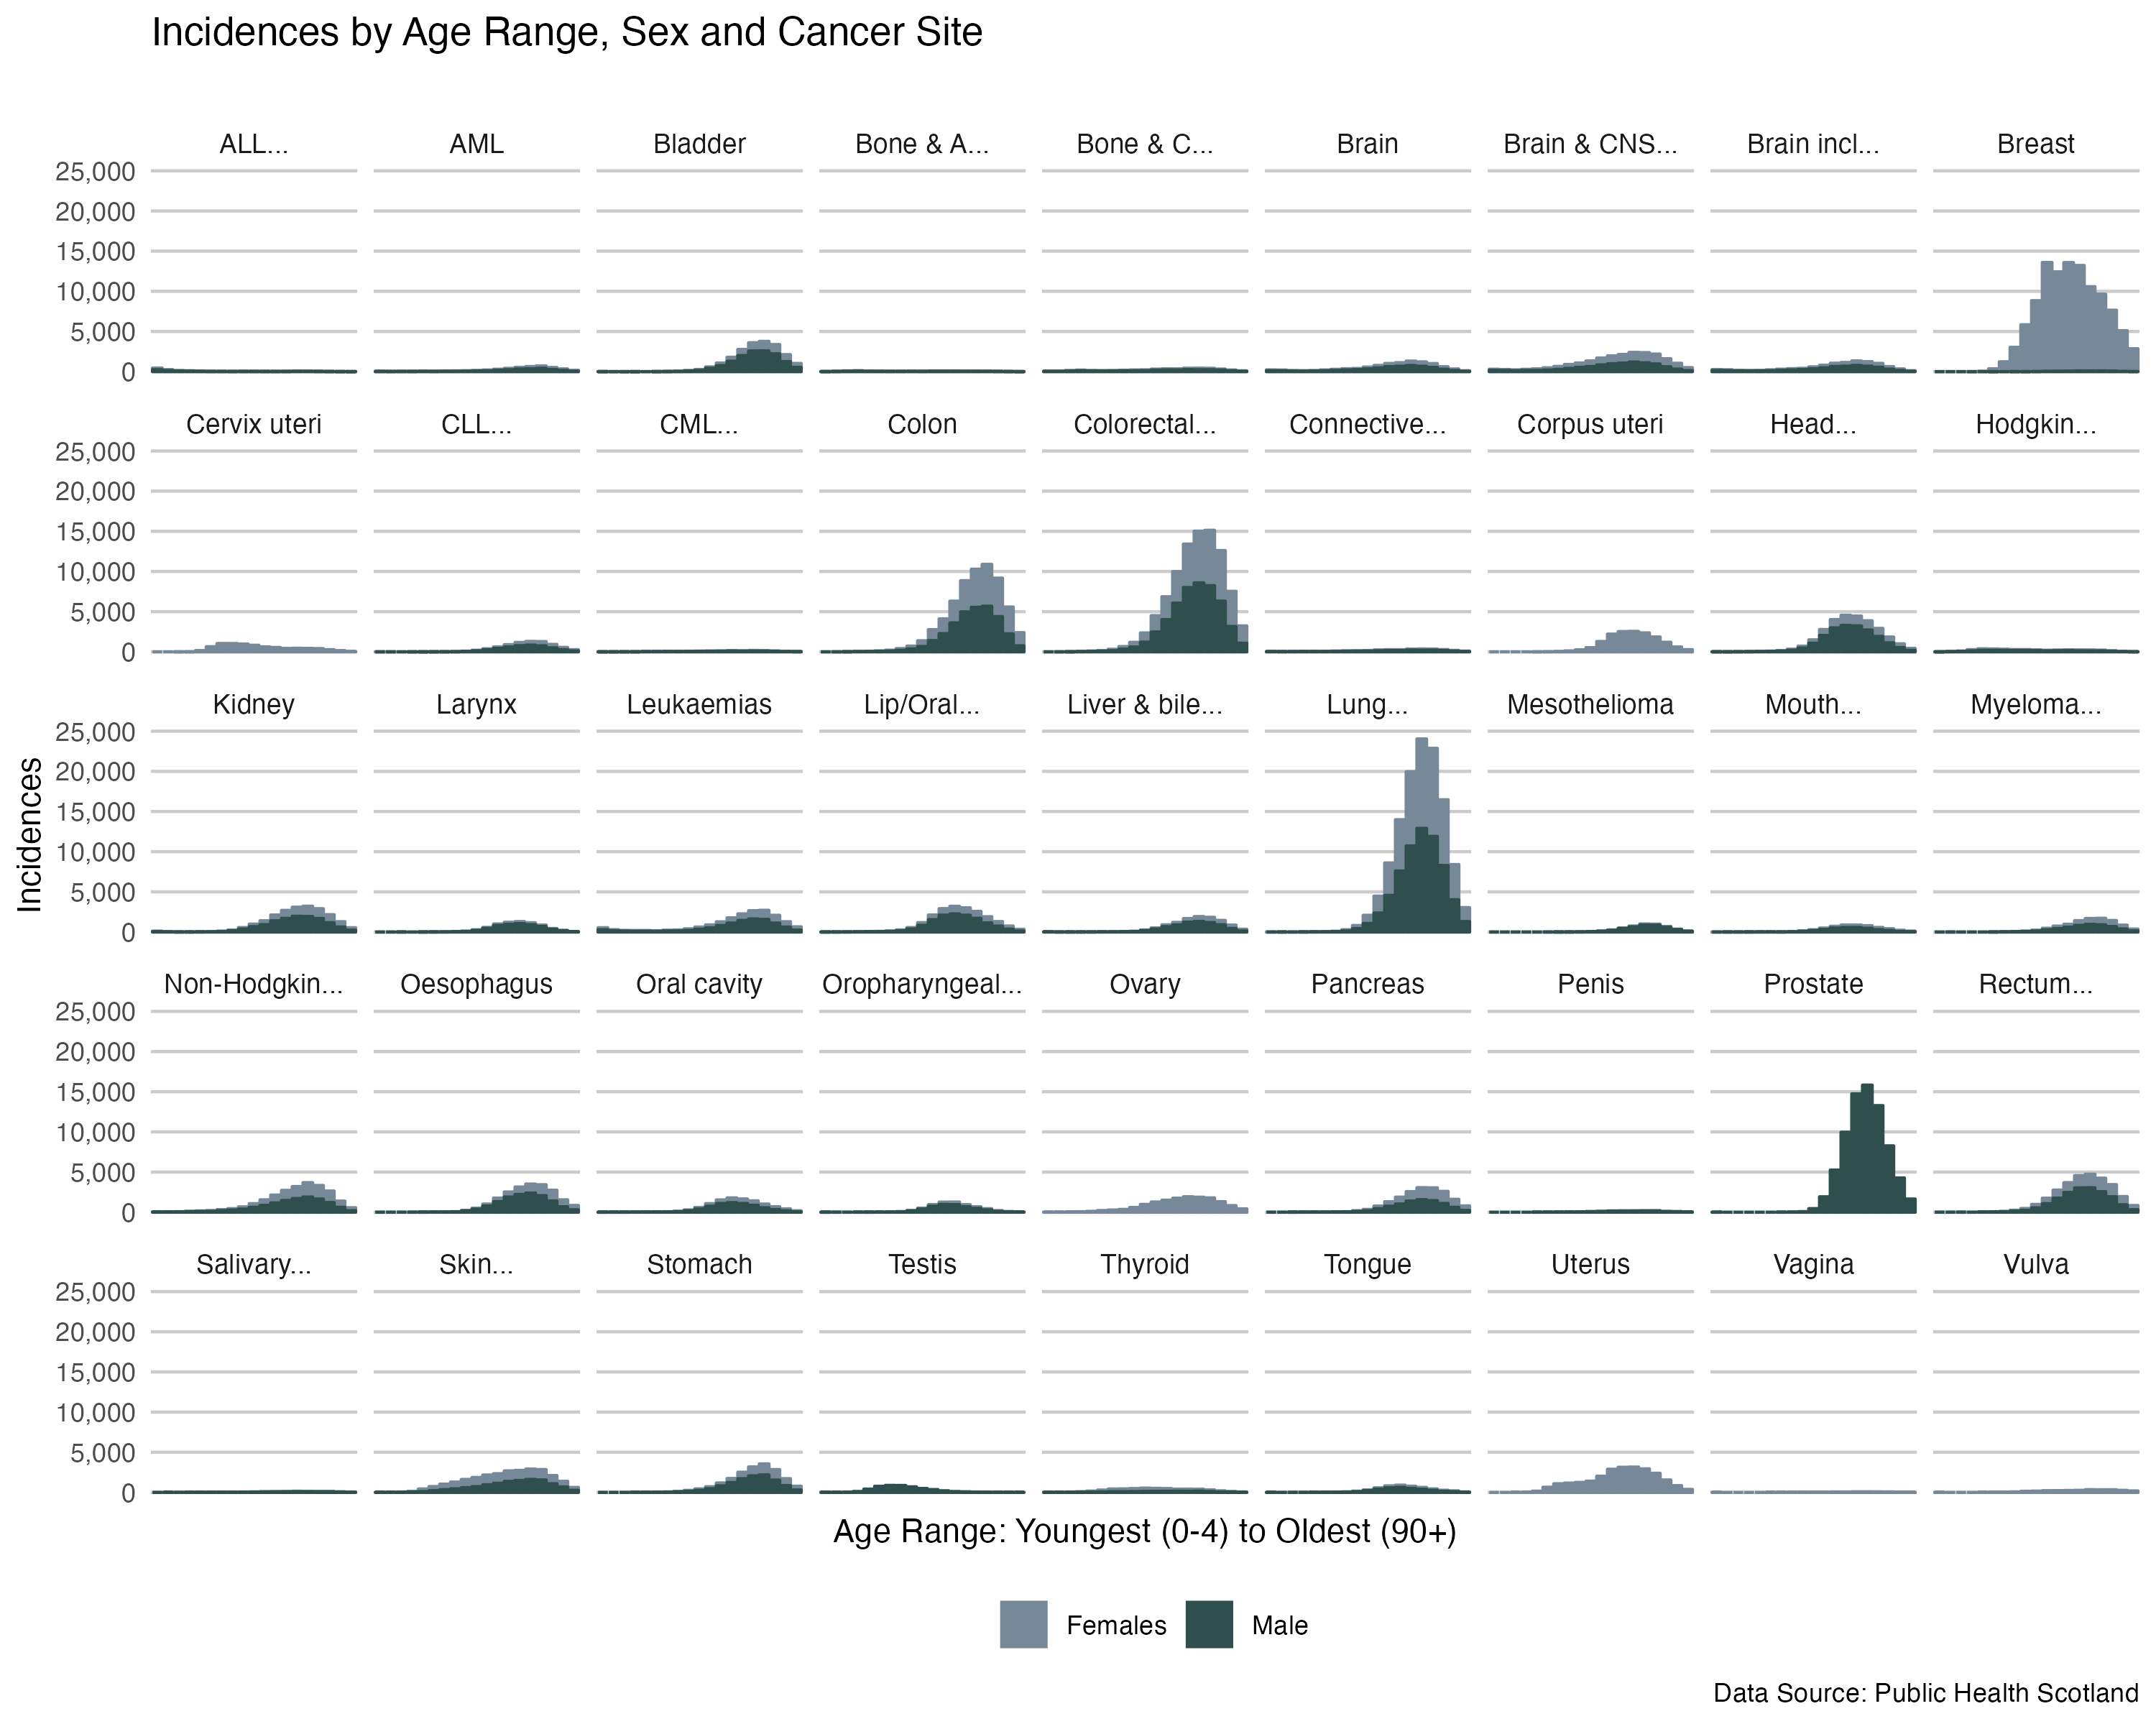
Notes:
Risk of developing cancer increases substantially with age

Slide 15
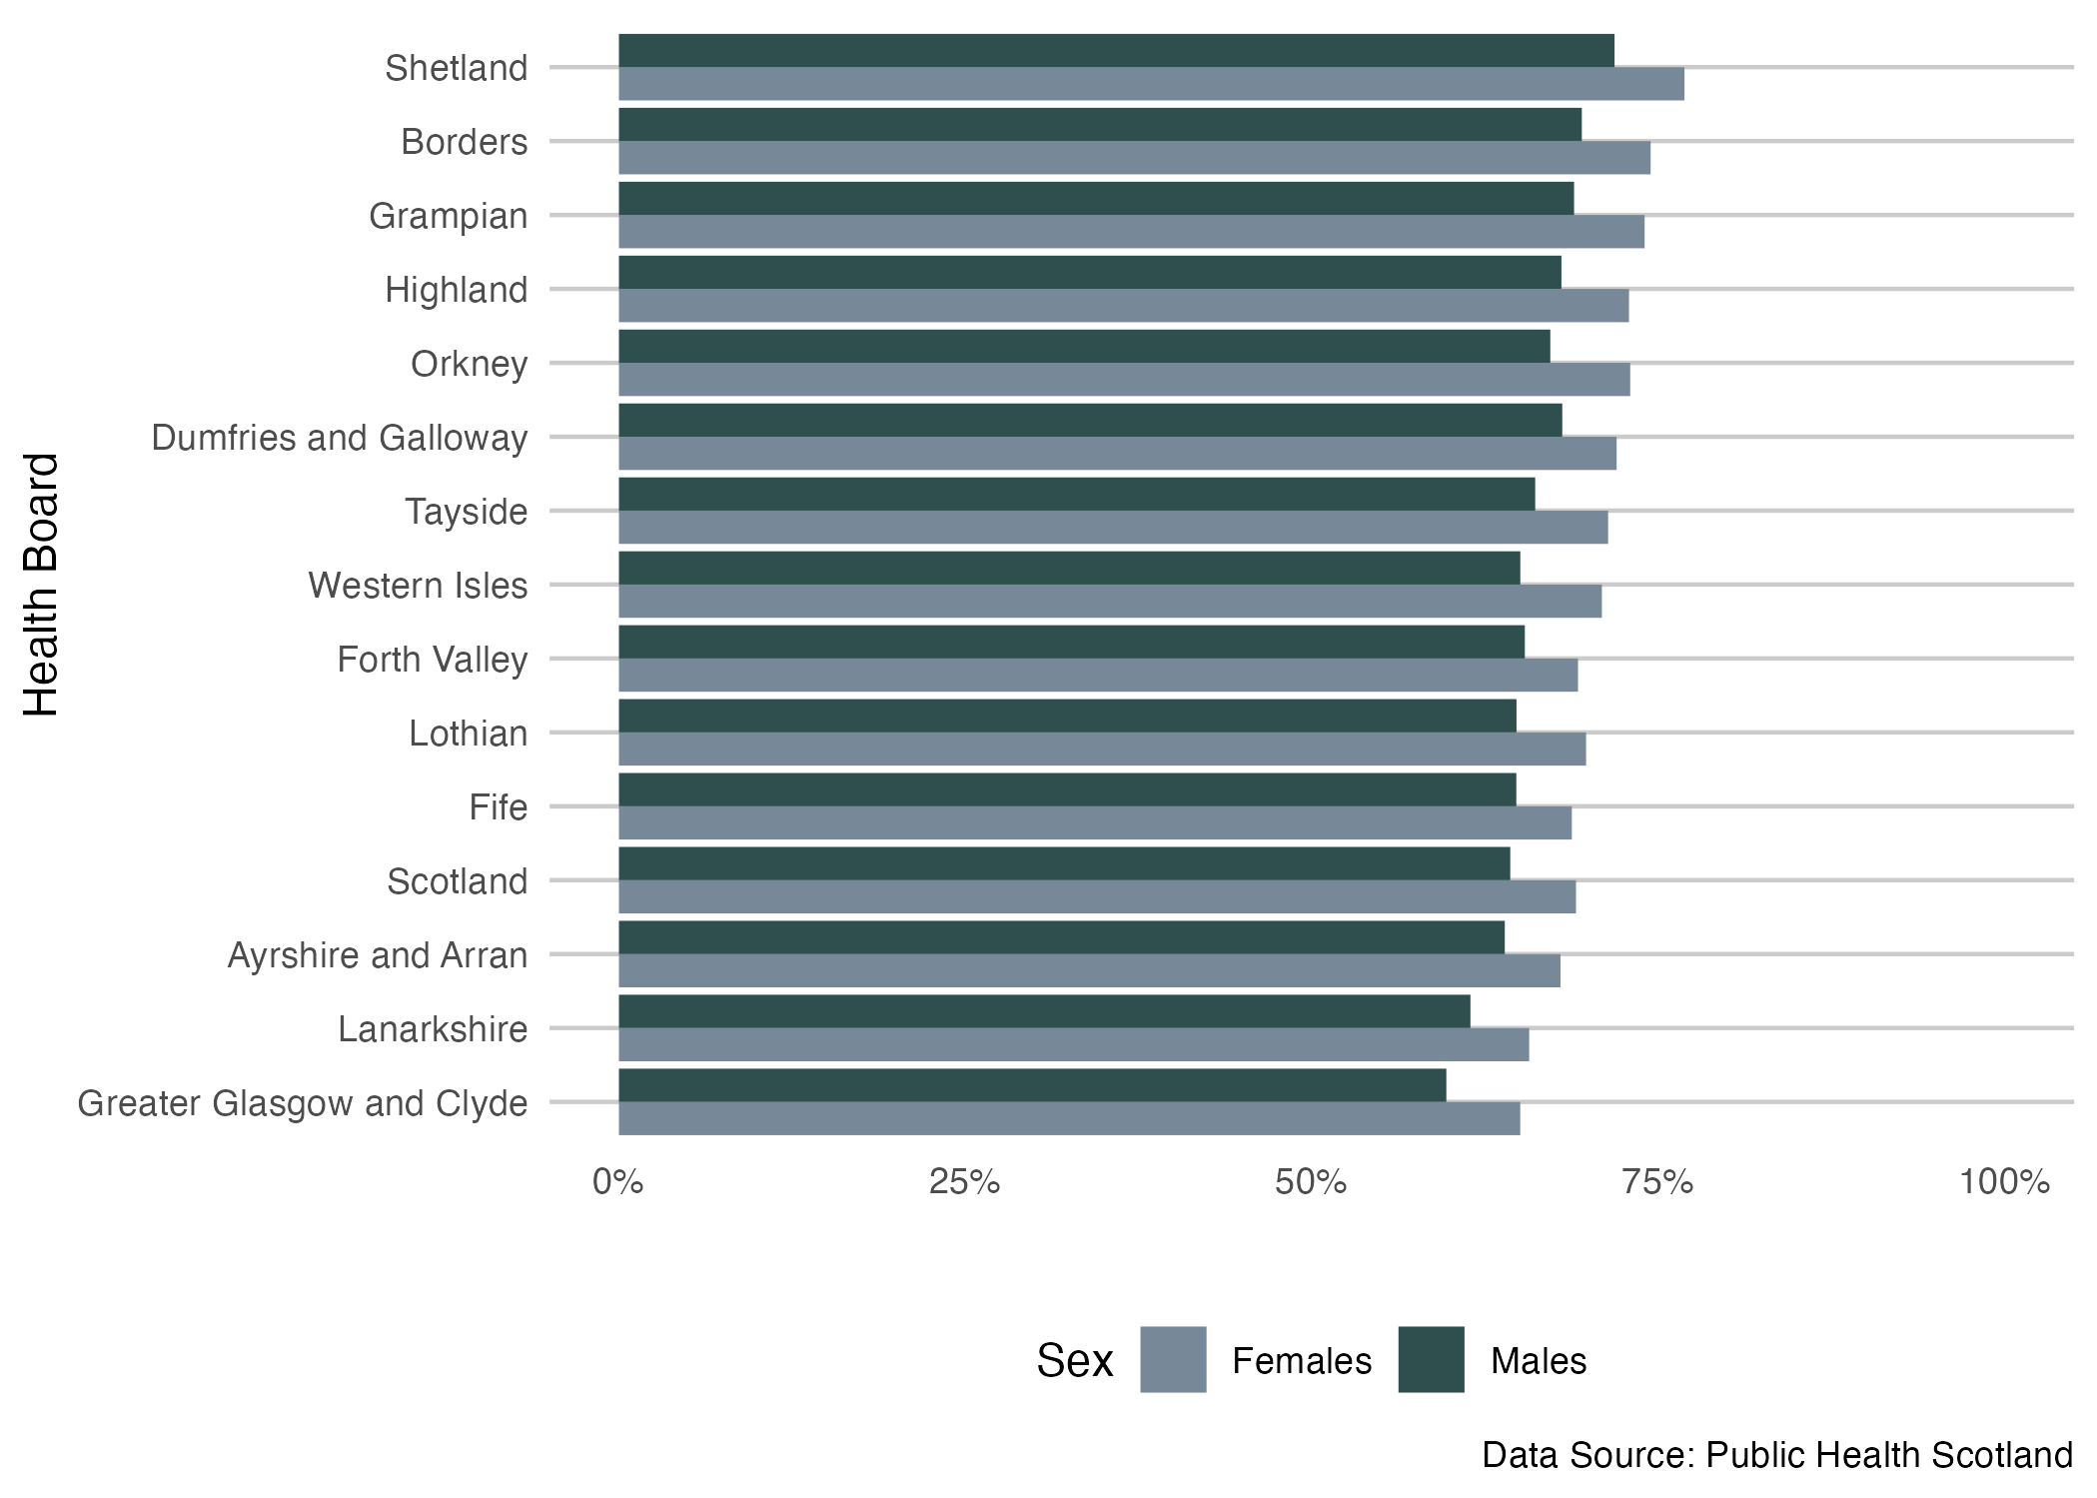
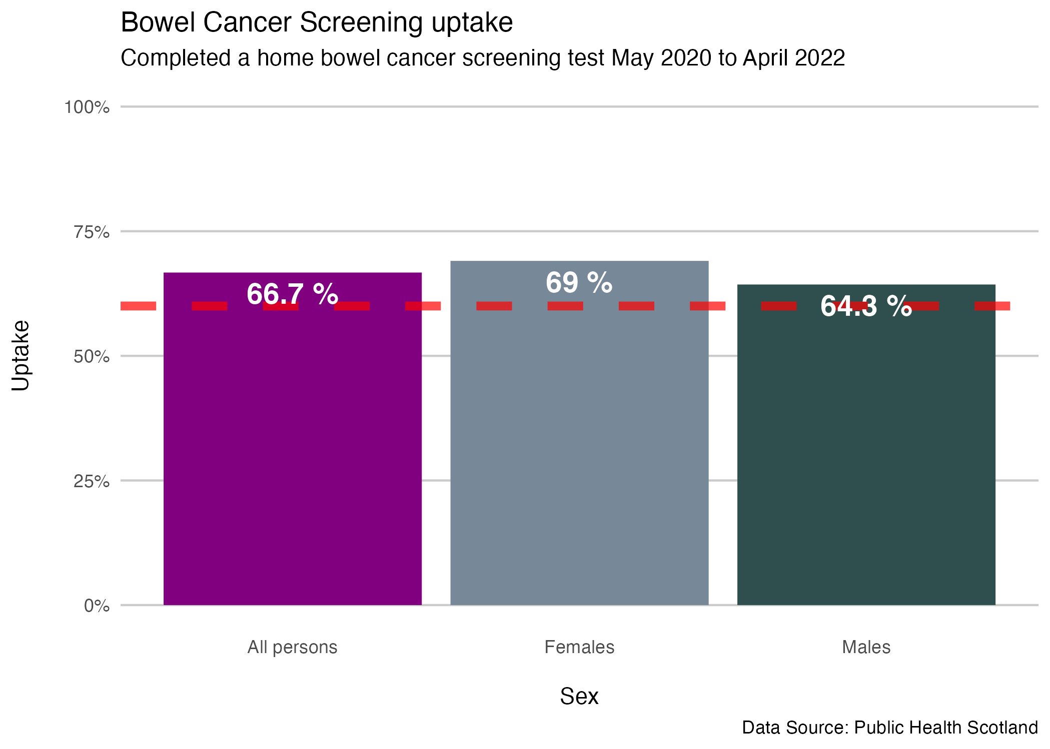
Insights - Screening
Notes:
The red dashed horizontal line marks the Health Improvement Scotland standard target of 60%.
This shows that in the current Bowel Cancer Screening latest results around 2/3 of the people invited via the screening programme are taking up the offer.
Females are more likely to return the tests than males.
Bowel Cancer Screening Uptake
Data for May 2020 to April 2022
Sex Health Board Uptake (%)
All persons Scotland 66.7
Females Scotland 69.1
Males Scotland 64.3
Data Source: Public Health Scotland
For the most recent round of testing the target has been met and exceeded by a clear margin.
Continue to enhance communication to try and engage the remaining third of the general public making more efforts to target males.

Slide 16
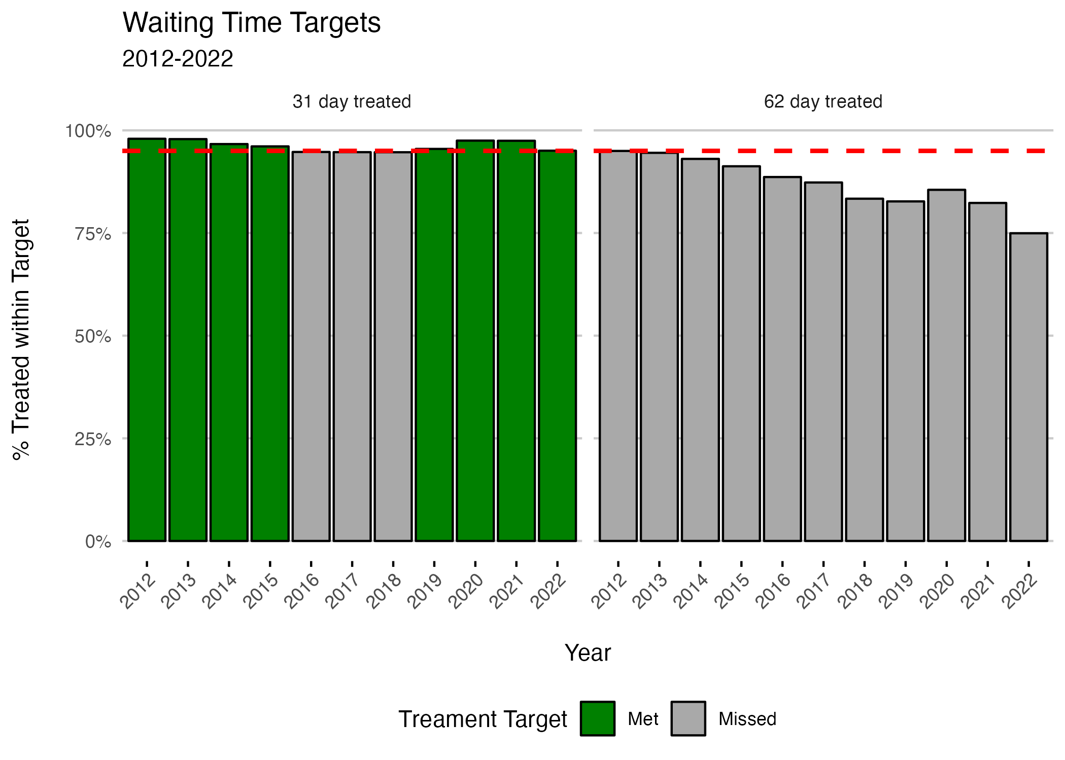
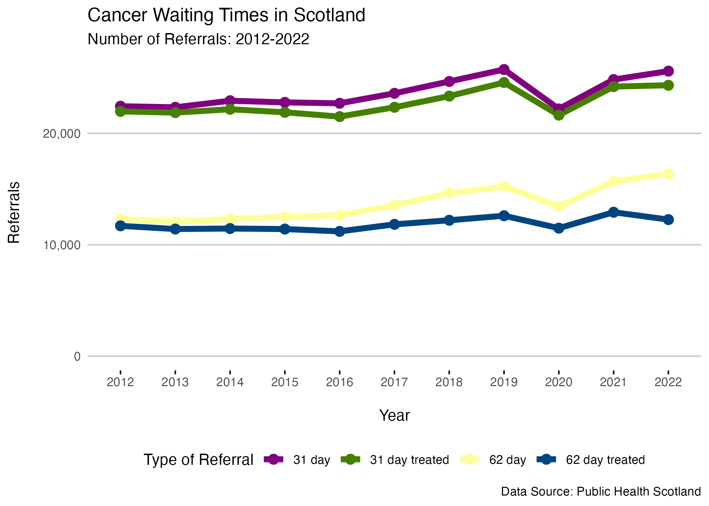
Insights Waiting Times
Notes:
For progressive diseases like cancer early treatment is important to improve the chances of a better outcome for the patient.
In the publication Better Cancer Care, An Action Plan, The Scottish Government has set targets that once a cancer has been diagnosed the patients should start treament within a partcular timeframe.
“…Current standards for cancer waiting times are that 95% of all eligible patients should wait no longer than 31 or 62 days…”
For this we will be using Public Health Scotland dataset for Cancer Waiting Times. “Cancer Waiting Times statistics for the 62 day standard for patients urgently referred with a suspicion of cancer to first cancer treatment and for the 31 day standard for patients regardless of the route of referral from date decision to treat to first cancer treatment.” - Public Health Scotland

Slide 17

Implementation
Another data in cancer registry that could be opened to a wider audience?
Treatment needs to start sooner. Rethink strategy?
Cancers vary by type across age groups. Use digital technology to provide tailored risk advice re symptoms for differing age groups/sexes and parents for signs in children.
Make it easier to access data programmatically for use by dashboards - URLs
Landscape of multiple organisations different websites – rank poorly in search engines, less online visibility/traffic.
This Photo by Unknown author is licensed under CC BY.
Notes:
If your solution would require implementation, discuss how this could be done​

Slide 18

Enhancements
Vaccination programme – prevention!
Breast and Cervical Screening
R shiny app hosting for Cancer Risk Tool
Notes:
Any enhancements you would pick up if you’d had more time

Slide 19

Lessons - Cancer
Death causes other than cancer…dementia looks scary!
Good news re cancer rates even if small.
Wide variation in which cancers at which age - how do we inform the public regarding symptoms?
Major problems with meeting 62 day target. Failing to treat people as soon as possible after diagnosis
Was not aware that non-malignant skin cancer was excluded. Revisit with climate change?
Notes:
Any lessons for the future

Slide 20
Lessons - Data
Check accompanying reports of datasets – contained essential information not present in data dictionary
Watch for datasets that include totals – can end up double counting if don’t filter out
'All' ...is it really? Double check if there are exceptions/caveats
Shiny documents useful for exploratory work
Reading Excel with multiple tables – use 'range' argument of read_excel to retrieve
R 'gt' package helpful for nice tables in markdown
Notes:
Public Health Scotland active R users of and dashboard creators. They are gradually building up their opendata repository
National Records of Scotland – beautiful charts, plain English reports. But can’t always get a URL directly to a CSV file

Slide 21
Demo – Cancer Risk Tool
Shiny Document
Introduction to interactive documents https://shiny.posit.co/r/articles/build/interactive-docs/

Slide 22


